Slide 1
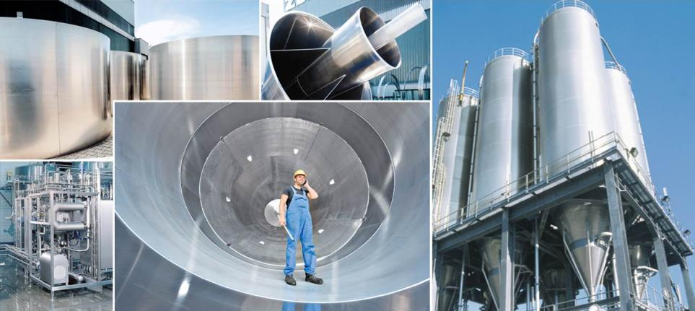
technology of raw materials handling for technical rubber plants
Dr. Semen Chlesberg,
Senior Manager Sales
28.01.2016

Slide 2
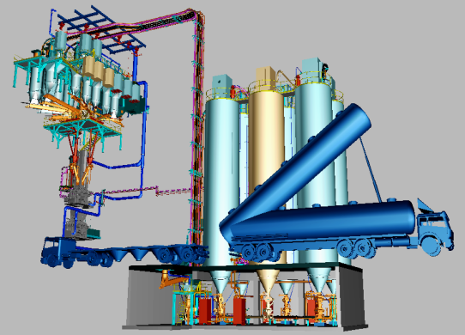
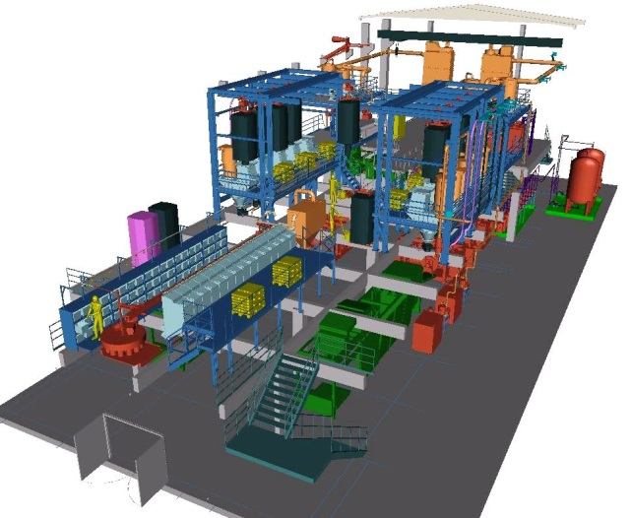
Plant Engineering for „Rubber & Tire“ Applications
Upstream equipment of mixing room – online system
Request for upstream/mixing room design:
mixture performance – t/h,
storage per ingredients - m³,
mixer – m³/cycle - min,
system accuracy - %,
site data, regulations
Mixing room processes are one of the basic step for Rubber/Tyre manufactures and performs usually in separate building or room…mixing room.
The main phases of the handling technology are:
unloading and handling of ingredients
storage and conveying of it to provide continuously operation of a plant
conveying to mixing lines and storage in day bins for
feeding, dosing and weighing of ingredients to provide batch recipe and
feeding and filling of openings of mixer in time.
Tyre plant
Rubber plant

Slide 3
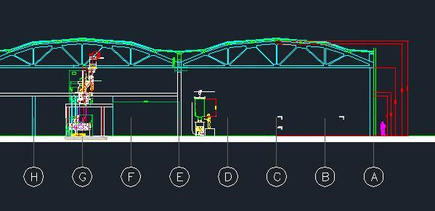
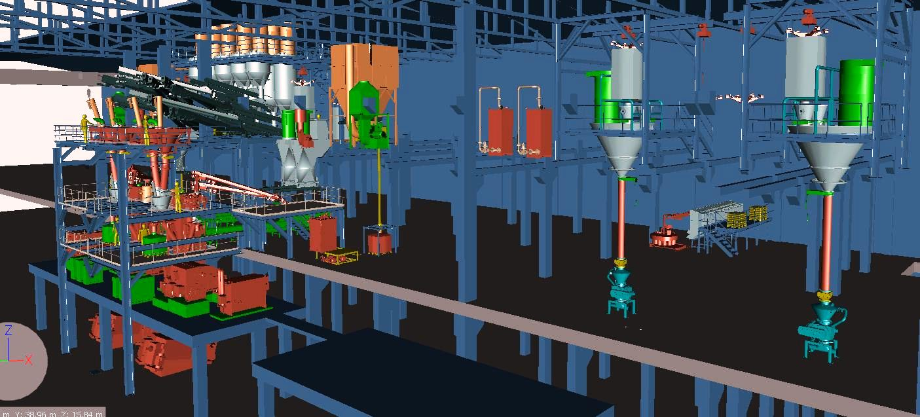
Plant Engineering for „Rubber & Tire“ Applications
Upstream equipment of mixing room – online system
The main requirements to mixing room technologies:
safekeeping of supplied Ingredients during unloading, storage and handling till mixer
providing uninterrupted operation of mixing room with waste free & environmentally friendly options
providing of handling for selected recipes with defined accuracy and repeatability … Cpk
providing defined cycle time and residue-free unloading in mixer
full automated control of the process with operator easy instructions.
selection and optimization of technology for customer available or designed building especially in context high and civil requirements.

Slide 4
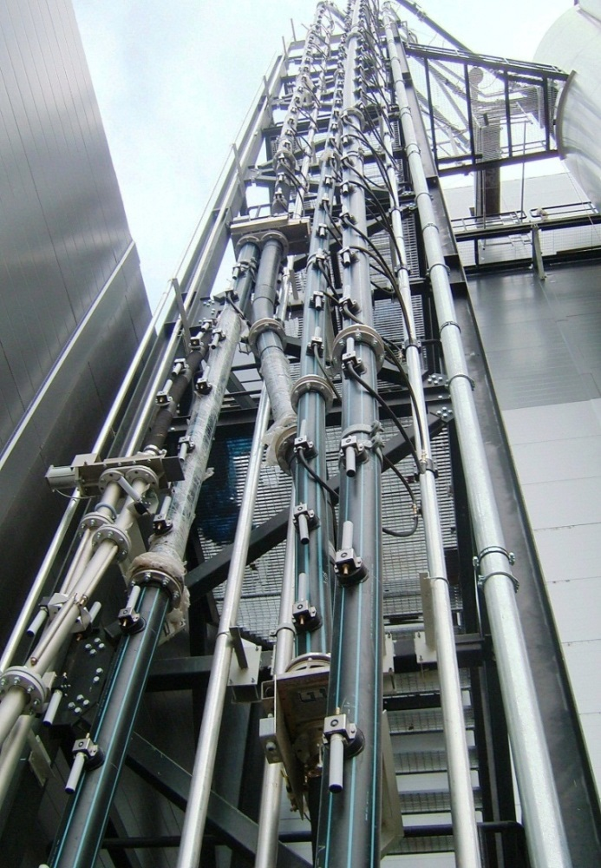
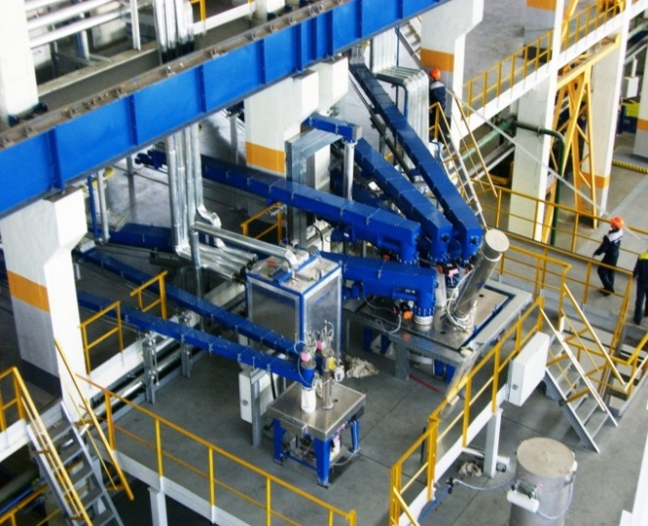
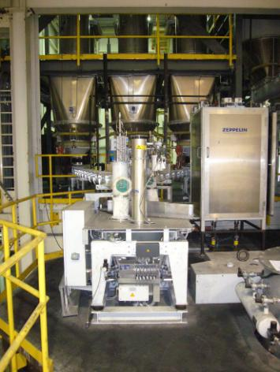
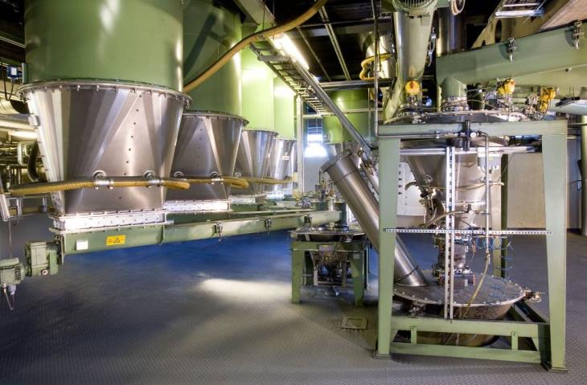
R & T Presentation Technical Details
Upstream equipment of mixing room – online system
And not forget: …………
individual units and systems
work at very different conditions

Slide 5
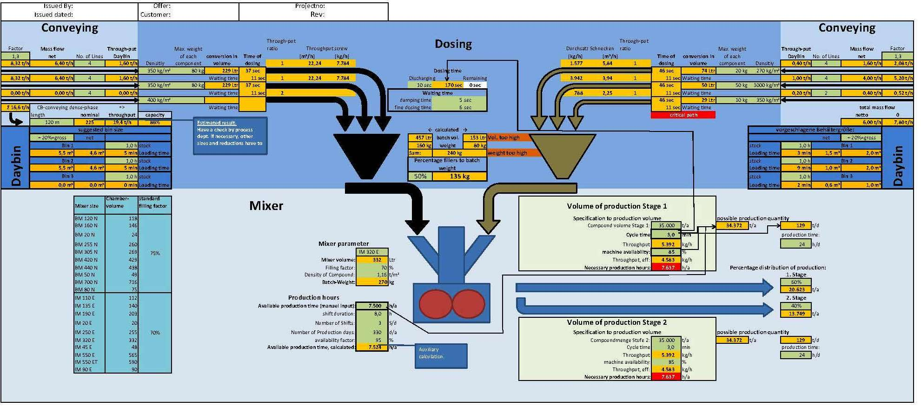
R & T Presentation Technical Details
Carbon Black, Silica and White dosing, weighing and charging of mixer
Engineering and Design - basic steps:
flows & balance of materials and selection of storage/work ing volumes
calculation of selected conveying systems, takes in the account requirements of customer
selection and calculation of capacity and dimensions of individual units
selection and design of interface units, adapters to provide operation of full system

Slide 6
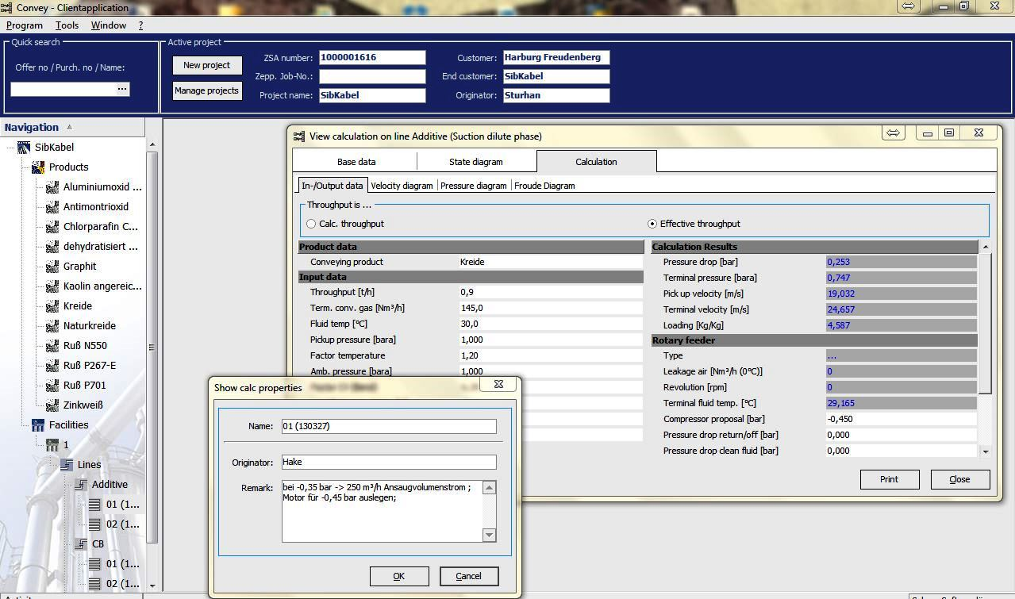
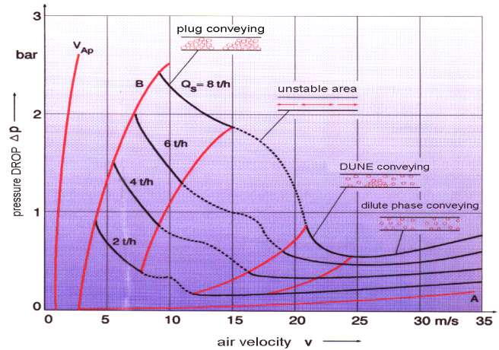
R & T Presentation Technical Details
Selection and calculation, design of conveying systems: dilute/dense phase conveying, capacity & dimensions

Slide 7
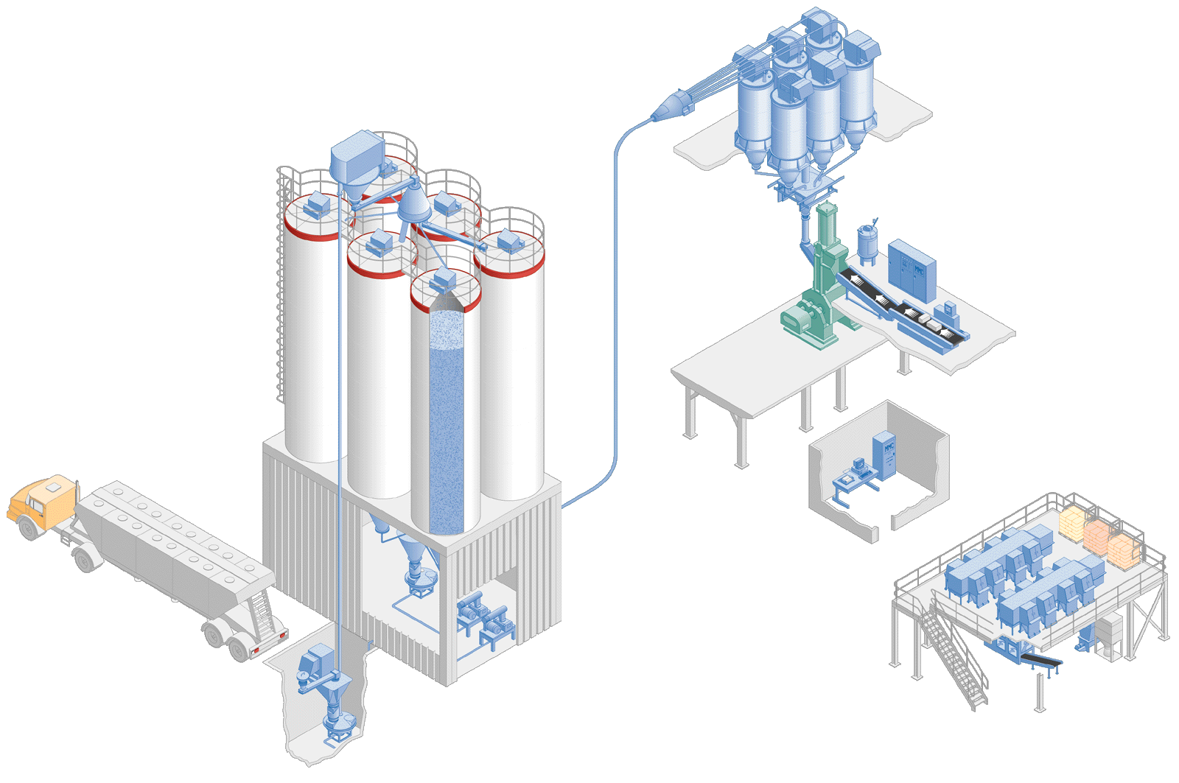
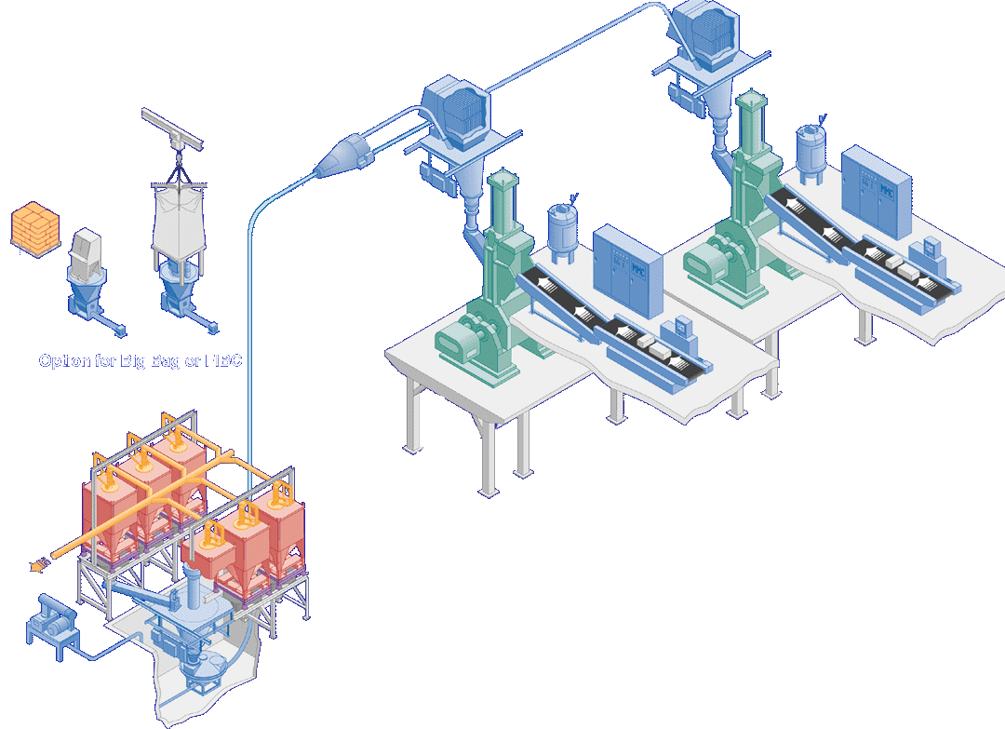
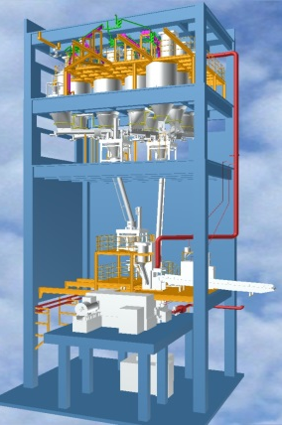
R & T Presentation Technical Details
Concept of carbon black, silica and white filler dosing, weighing and charging of mixer
Batch transfer D&W system
Ingredients transfer D&W system
Disadvantages or open points:
CB destruction by dilute conveying…
What remains in filter? Check weighing is no explanation...
Residue in pressure vessel….
Caking in piping….
Recipes, ingredients mixing…
Statement about prescription accuracy…

Slide 8
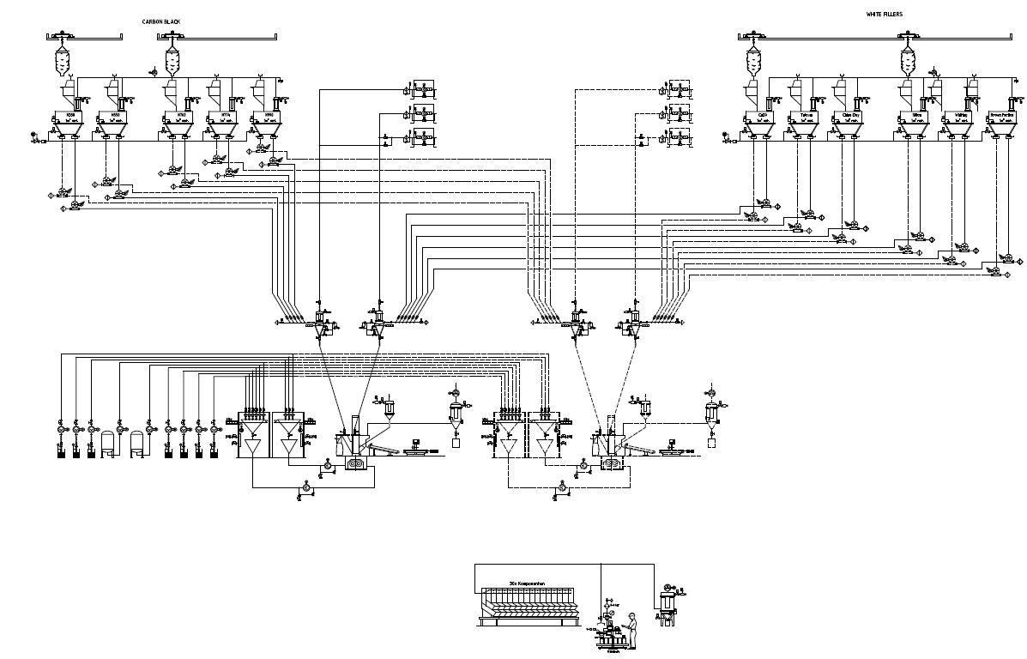
R & T Presentation Technical Details
невысокиеnbot like
Main features for technology & design of technical Rubber Mixing Room
Lower capacity of mixing lines (not as tire plant)
Longer batch cycle time > 3-10 min
Big variety of ingredients (bulk materials & fluids)
Big variety of ingredient‘s packing
Big variety of weighing values
Frequent changes of recipes
Low cost (2-floors) building rooms (tendency)
Short distance of materials conveying (fines)
Requirement of reduced investment for total project
High requirements (like as Tire plant) to quality of mixing!

Slide 9
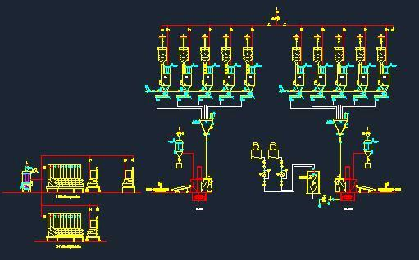
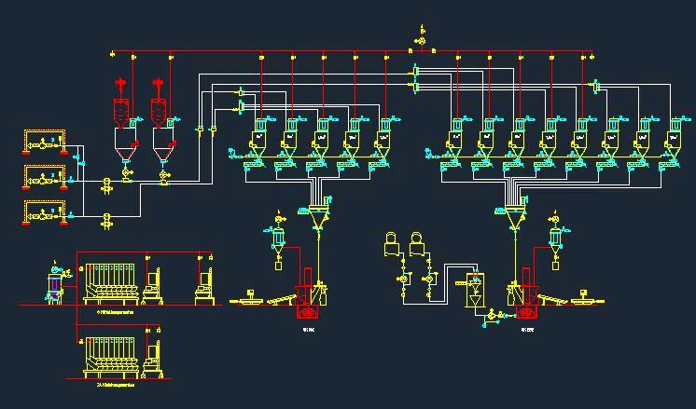
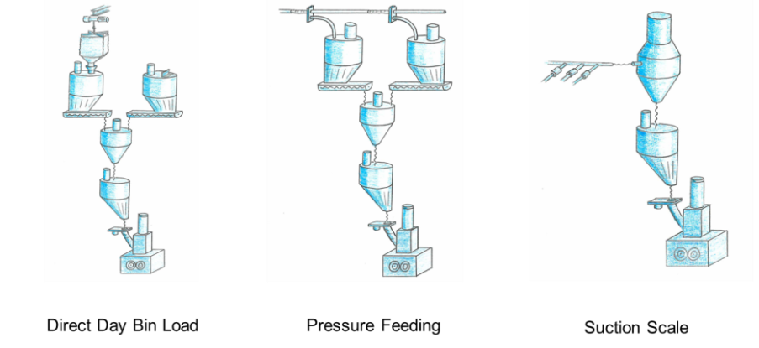
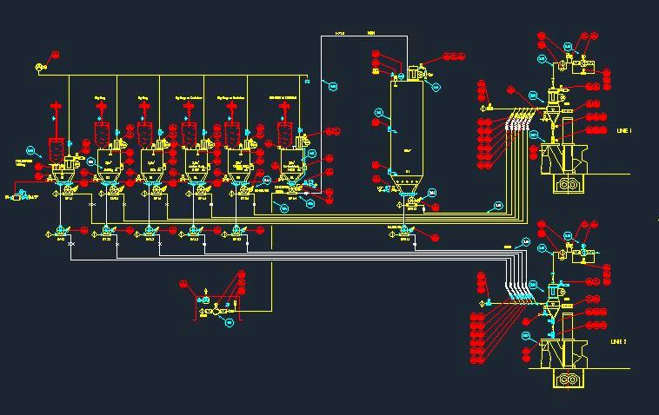
R & T Presentation Technical Details
Carbon Black, Silica and White dosing, weighing and charging of mixer
Bags/ Big-Bags unloading, gravimetrical handling
Bags/Big-Bags unloading, pressure pneumatic conveying
Bags/Big-Bags unloading, suction pneumatic conveying
100 %
190 %
80 %

Slide 10

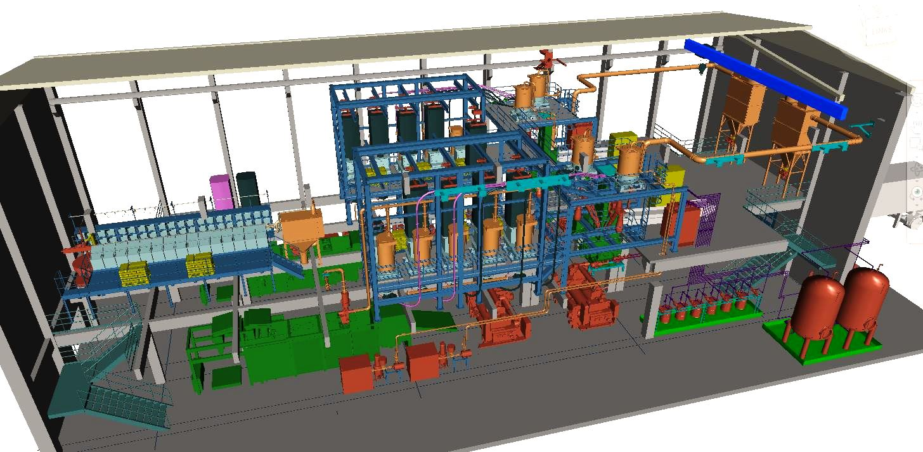
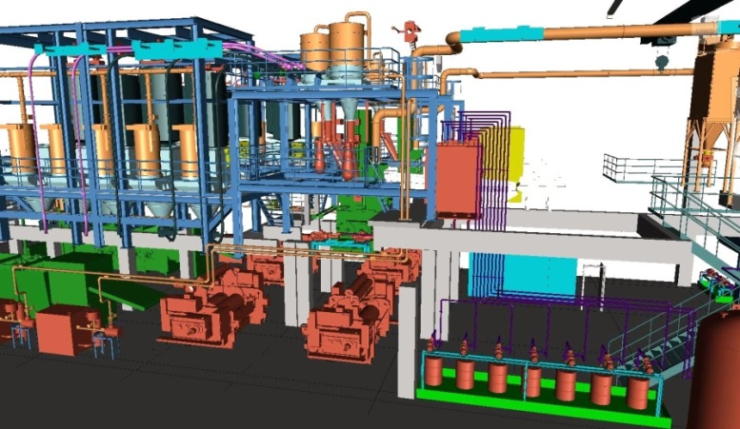
R & T Presentation Technical Details
Concept of low cost building with full state of the art technology of mixing room
Concepts includes:
Trucks, Bags/Big-Bag unloading stations (level 0),
Suction conveying/dosing system from storage bins to pneumatic scales,
Oils storage, dosing, feeding systems (level 0),
Small components weighing systems (off-line, level 0 or 1),
Set of weighing & feeding belts,
Aspiration system, mixer, downstream, control system

Slide 11
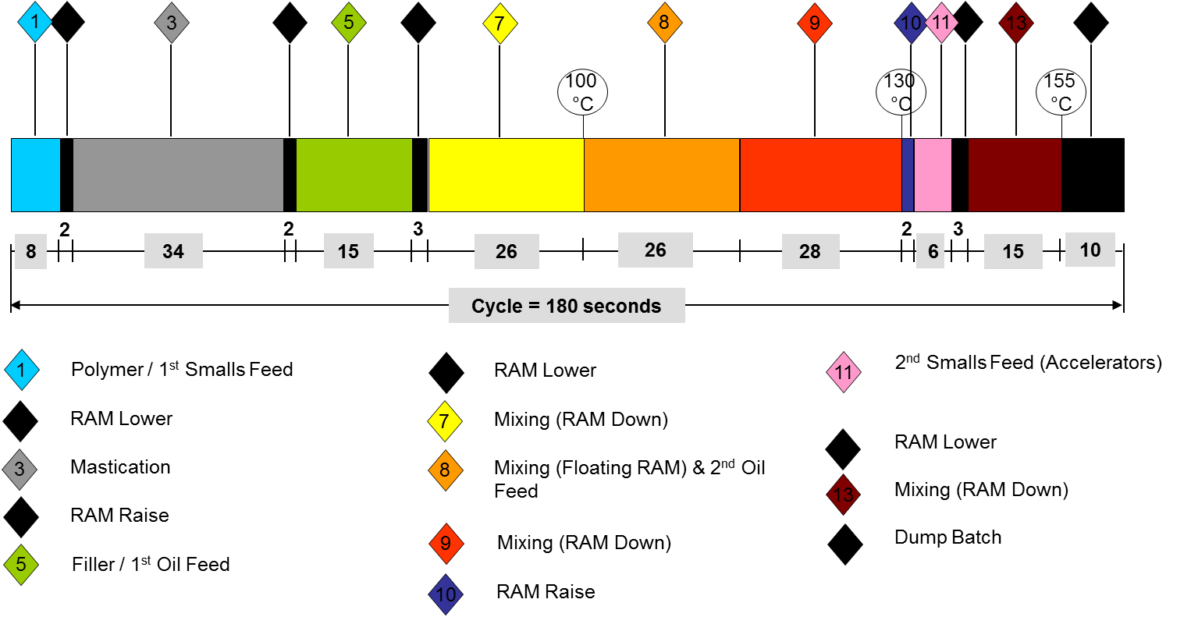
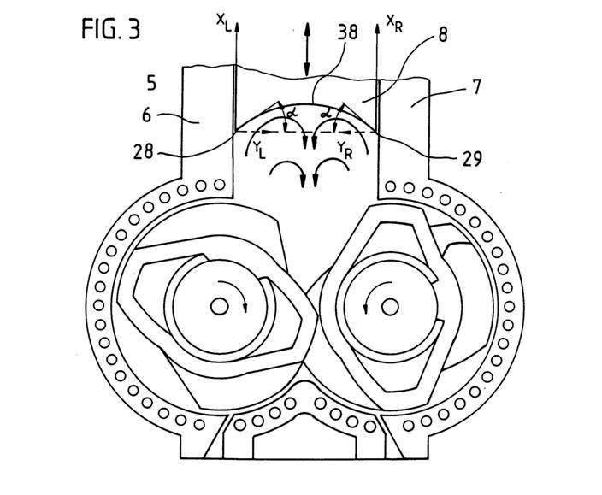
R & T Presentation Technical Details
Model Mixing Cycle
All features of raw materials handling, discussed till now have to provide continuous work of mixer according to schedule of mixing cycle
- Technical design, presented below enable us to meet requirements of modern mixers

Slide 12
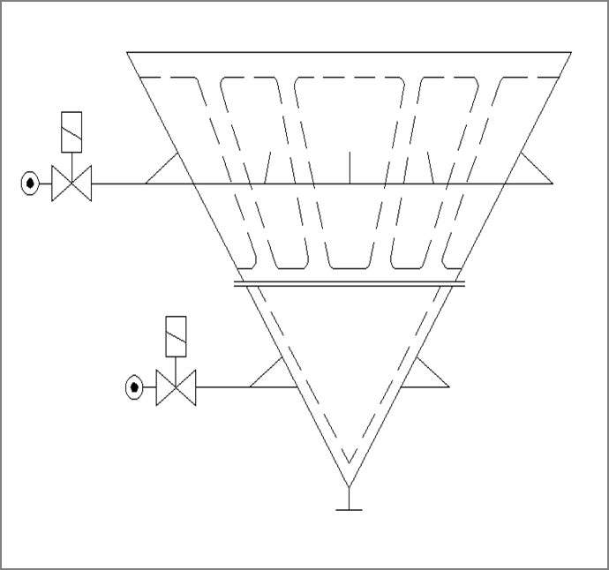
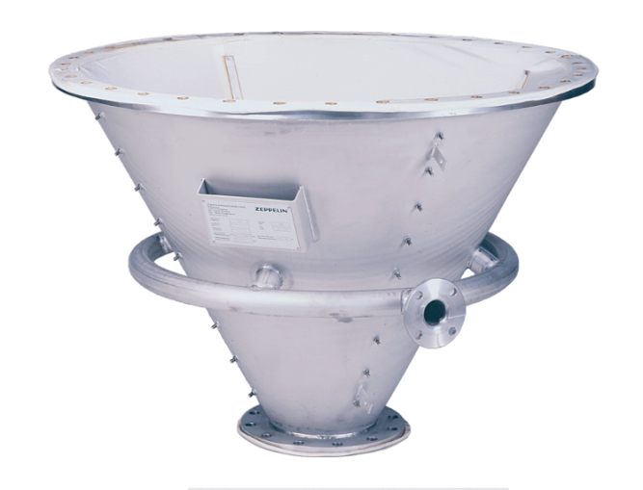
R & T Presentation Technical Details
Discharge aids
Reliable & Rapid Feeding
Need reliable & rapid discharge from silos / daybins.
Fluidisation ensures material availability to dosing & weighing system but requires a reliable supply of clean/dry air.
15

Slide 13
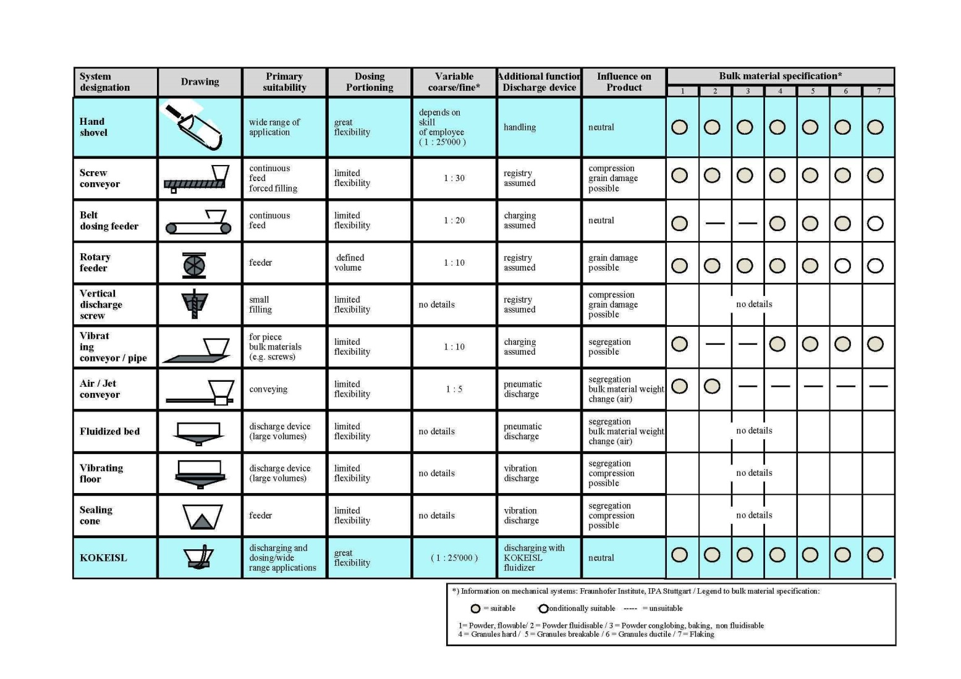
R & T Presentation Technical Details
Mechanical dosing devices
15

Slide 14
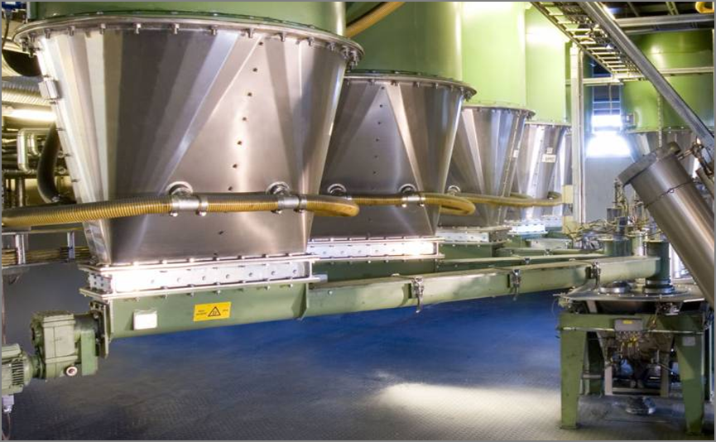
R & T Presentation Technical Details
Dosing fillers
15
Limitation of Single Screw
Example:
Total cycle time: 180
Less discharge time: -15
Dosing time net: 165 sec.
Fine dosing time: 45 sec.
Net time for coarse dosing: 120 sec.
Coarse dosing rate: 833 g/sec.
e. g. DN 200 Dosing Screw
Assume 10:1 turn down
Fine dosing rate: 83 g/sec
Assume 3 fillers (2 black + 1 white) with total weight 100 kg & accuracy required ± 60 g
Possible accuracy: ± 83 g

Slide 15
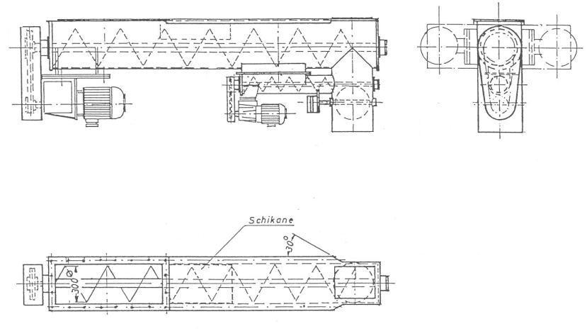
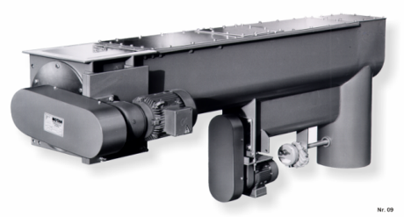
R & T Presentation Technical Details
Dosing fillers
15
Double Screw - better accuracy in a shorter time
Double Dosing Screw Arrangement:
Allows shorter dosing time & higher accuracy
e. g. DN 200 DN 100
capacity g/sec.: 910 128
Coarse dosing time
  reduces to 100 / 0.91 = 110 sec
Fine dosing rate
  reduces to 128 / 10 = 12.8 g/sec
Possible accuracy: ± 12.8 g*
Potential cycle time reduction of 10 sec.

Slide 16
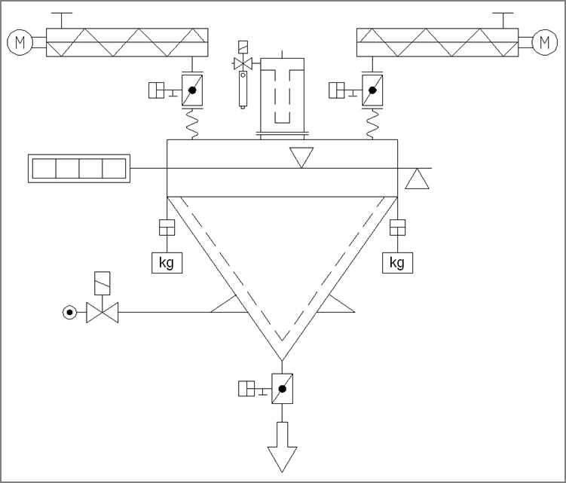
R & T Presentation Technical Details
CB, Si, WF bulk materials, Scales
15
Designed for standard accuracy requirements
Fluidised Aluminium Scale: ± 0,25 % FSV
isolation valve to prevent flushing
allow for “in-flight” material in weighing program
automatic calibration option
ensure scales are not installed between floors to reduce “draft” influence
butterfly valve presents a “shelf” for material to hang up on during discharge

Slide 17
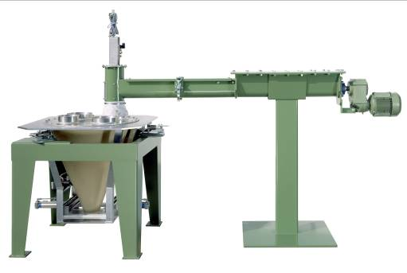
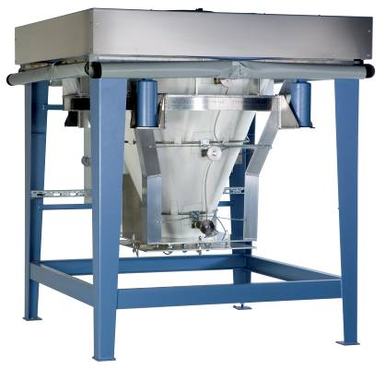
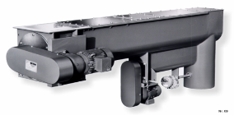
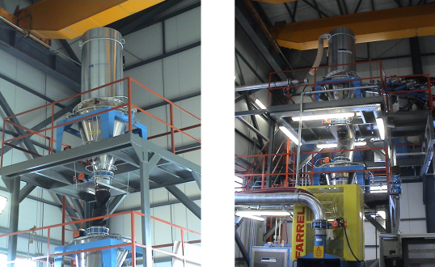
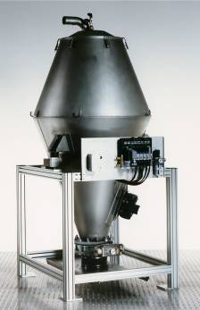
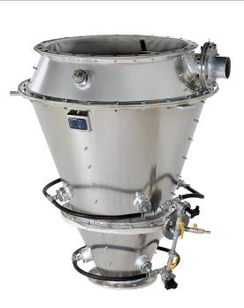
R & T Presentation Technical Details
CB, Si, WF bulk materials, Scales
15
Designed for high accuracy requirements
Rubber Scale: ± 0,1 % FSV
3 load cell weighing
substantial frame (helps dampen vibration)
wind guards
non-stick rubber hopper
vibration during discharge
large/full-bore discharge valve (e. g. mechanical pinch type)
vent filter part of “weighed” assembly
filter cleaned during discharge
vibration damping mounts
Suction scale

Slide 18
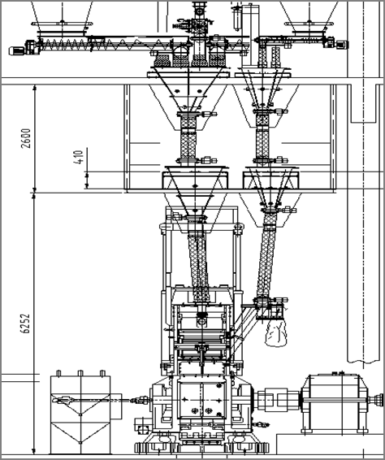
R & T Presentation Technical Details
Waiting hopper
21
Can be helpful when charging powders to mixer in 2 steps
Ensure mixer is not “waiting” for charge to be prepared
or:
Ensure system is not “waiting” for mixer to be ready before it can empty and prepare next batch
Penalty is increased height!

Slide 19
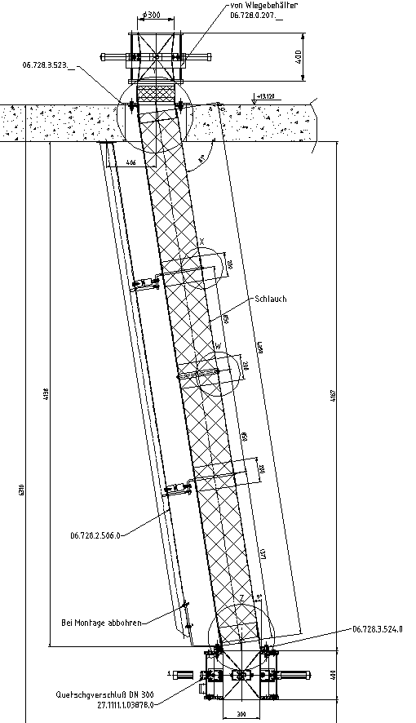
R & T Presentation Technical Details
Transfer chutes
21
Weight of chute isolated from scale
Flexible non-stick rubber glued rather than stitched to avoid hold-up
Additional support for long off-vertical chutes. Easier implementation for overhead cranes.
Chute vibrators to minimize sticking
(< 10 g/m without incremental build-up)

Slide 20
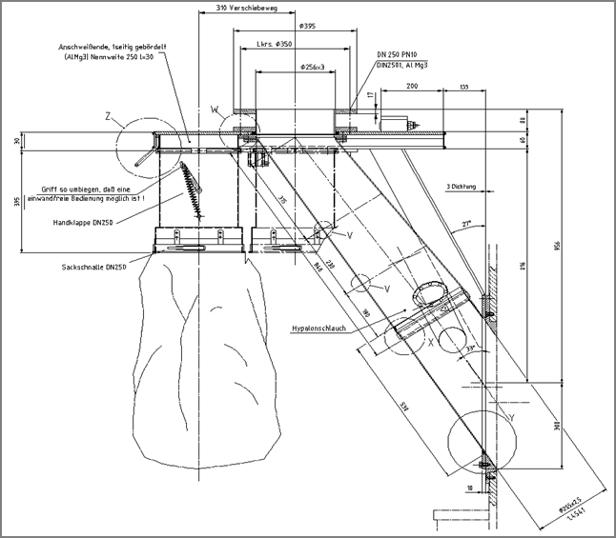
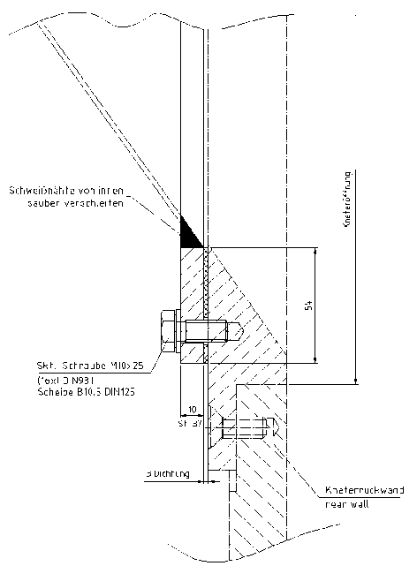
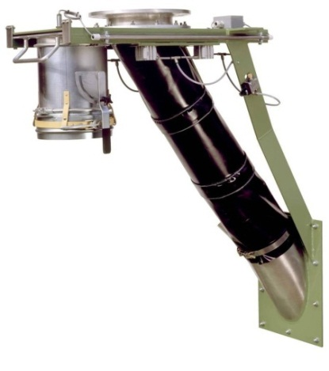
R & T Presentation Technical Details
Mixer feed door –
can effect accuracy of batch
21
Design of mixer feed door should avoid “shelves” where powder can hang up.
Ensure good interfacing between suppliers.

Slide 21
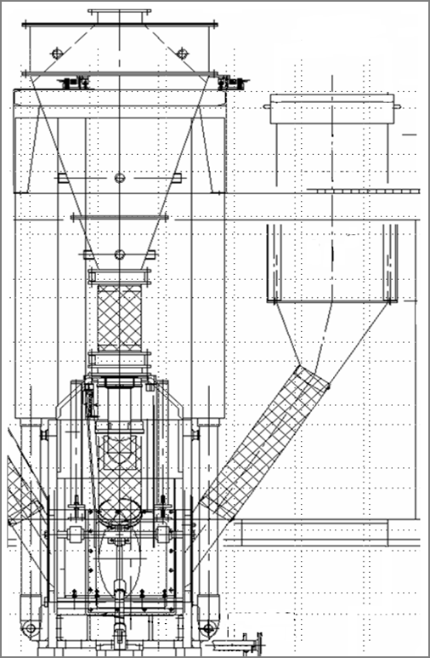
R & T Presentation Technical Details
Ram Relief Filter
3
3
Improved Accuracy, Efficiency & Reliability
As ram lowers air is vented via local filter
Filter cleans during next ram raise returning fillers to batch
Decreases loss of powder fillers to central aspiration (approx. 20 % of normal losses)
Reduces build-up on ram
Reduces environmental dust
Improves accuracy of batch
Reduces secondary handling of waste
Improves isolation of vacuum / pressure effect during Ram movement
connects to side door of mixer

Slide 22
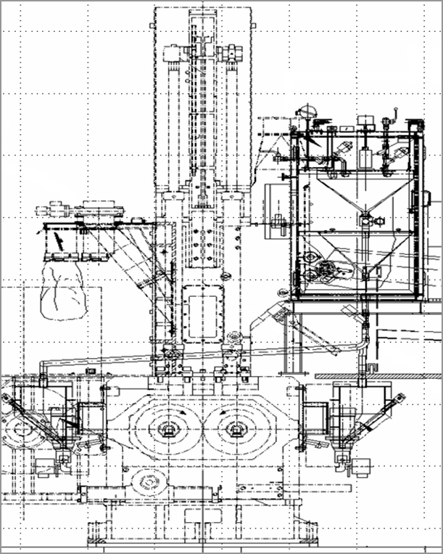
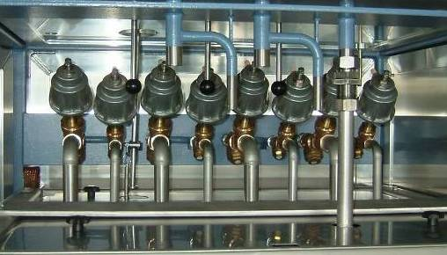
R & T Presentation Technical Details
Oil Dosing & Injection
26
Purpose designed to suit your application
Locate scale & pump as near to mixer as possible
Single or double dosing valves – depending on accuracy (up to ± 0,1 % FSC)
Single or double hopper scale – depending on compatibility of oils and accuracy requirements
Design pressure flow of pump depends on mixing philosophy and injector type
ram down injection (up to 75 bar) can reduce cycle time and help to prevent putting batch to sleep
avoid horizontal transfer pipes

Slide 23
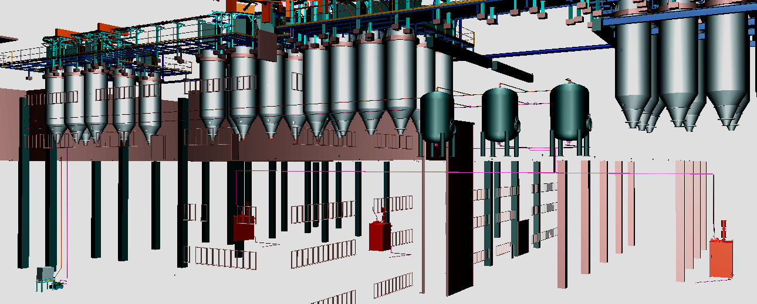
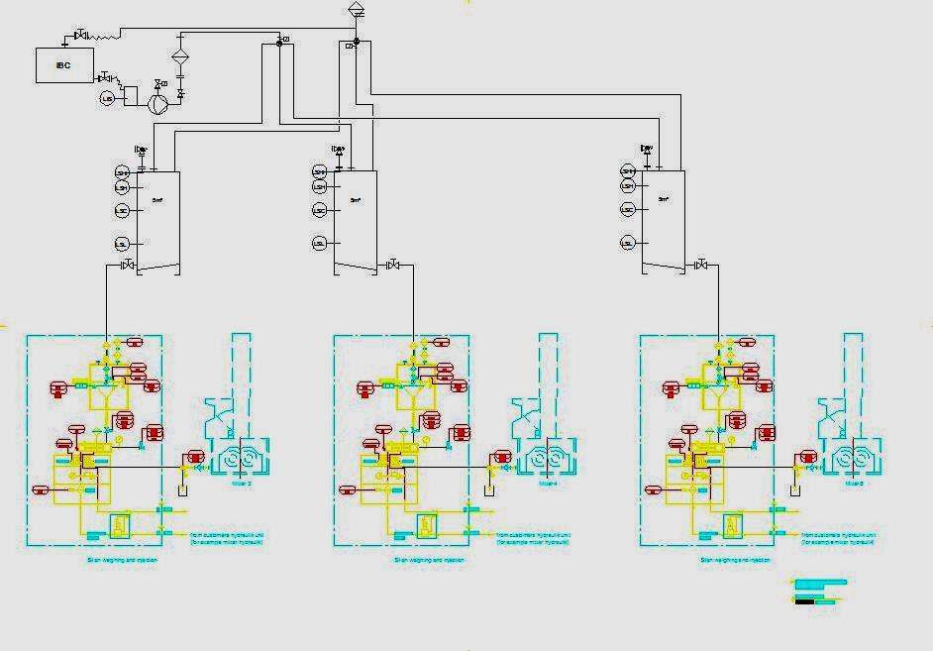
R & T Presentation Technical Details
Upstream Equipment of Mixing Room – on line
Silane Dosing and Weighing System
26
complete with…
storage container stations
gravimetrical weighing unit
syringe Pump for Silane
injection piping & valve on mixer

Slide 24
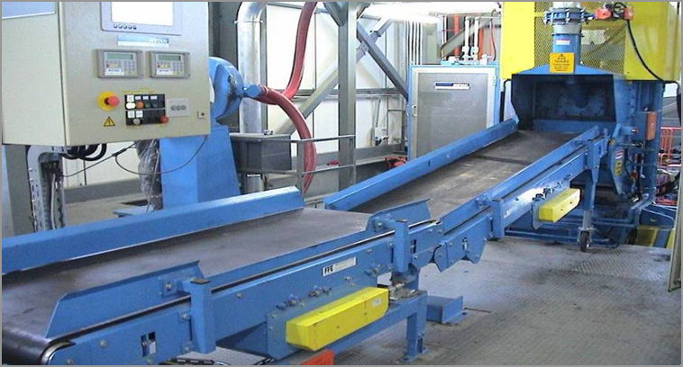
R & T Presentation Technical Details
Polymer Weighing & Charging
8
Fast & Ergonomic designs
Controls with easily readable visualization and easily reachable buttons / pedals
Size of belts must consider polymer / smalls batch size and dimensions of door
Speed of belts | Bandscale | Charge Conveyor
Traditional | 0.6 m/sec | 0.6 m/sec
Latest | 1.3 m/sec | 3.0 m/sec
Time saving for 6 m charge belt = 8 seconds.

Slide 25
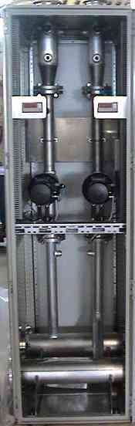
R & T Presentation Technical Details
Pellet Degradation
26
26
28
Influence on Pellet Degradation
pipe material / roughness è minimise
number of bends è minimise
distance conveyed è minimise
conveying velocity è minimise
number of handling stages è minimise
pellet strength
virgin fines content
conveying characteristics
Select a versatile conveying system that gives flexibility to raw material purchasers and plant operators
not in system designer’s / equipment supplier’s control
25

Slide 26
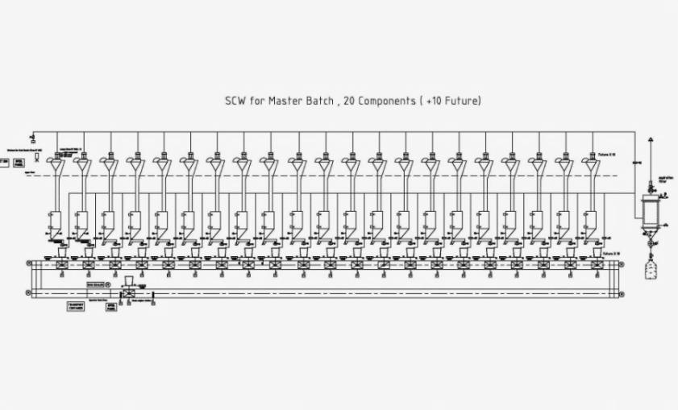



R & T Presentation Technical Details
Upstream Equipment of Mixing Room – offline
Automated Small Components Dosing and Weighing System
26

Slide 27




R & T Presentation Technical Details
Automated Small Components Dosing and Weighing System
Carousels
Roller and chain conveyor systems

Slide 28

R & T Presentation Technical Details
Double Dosing Screws
Double Dosing Screws:
Size: 125/40 mm
Vertical shutter for 2 screws
Main chain drive
Direct secondary drive
Discharge spoke wheel
Frequency controlled 6 – 78 Hz (1:10)
Drive power: 2,0 kW
Speed range: 24 – 250 RPM
Capacity: up to 700 g/s

Slide 29

R & T Presentation Technical Details
Vibratory Feeders
Vibratory Feeders:
Size 120 mm
Size 220 mm
Closed dosing channel
Adjustable layer height
Flexible compensator
Double magnetic drives
Thyristor controlled
93 V – 195 V AC 50/60 Hz
3 A @ 230 V AC

Slide 30
R & T Presentation Technical Details
Cycle Time and Accuracy
CYCLE TIME: | Manual Systems: | 20-40s / per component
 | Fully automatic systems: | 30-45s / per batch
 | Cycle time increments: | Coarse dosing 10 – 20s
 |  | Fine dosing: 3 – 10s
 |  | Conveying 5 – 10 s
 |  | Scale tare and scale movements 2 – 5 s
AVERAGE DOSING ACCURACY: | Double Dosing Screws 125/40: | +- 3g*
 | Dosing Screw 125: | +/-20g*
 | Dosing Screw 100: | +/-15g*
 | Dosing Screw 80: | +/-8g*
 | Vibratory Feeder 120 mm: | +/-3g*
 | Vibratory Feeder 220 mm: | +/-5-10g*
* Depending on physical properties of chemicals
* Use of dynamic dosing controller
Notes:
30

Slide 31
R & T Presentation Technical Details
Operational Limits
Linear Systems:
Maximum weight: 20 kg (16 kg US, OSHA) limited by bag strength
Maximum volume: 30 dm³ limited by net usable volume of dosing bucket
Carousel Type Systems:
Maximum Weight: 20 kg limited by bag strength
Maximum volume: 20 dm³ net volume of revolving hopper
Remark:
Recipes with higher volumes or weights have to be split to more bags
Notes:
31

Slide 32

R & T Presentation Technical Details
Operational Limits
Statistical Process Control
Process capability analysis
Process capability
Cp - normally distributed values
Cpk- normally distributed values
Cp = width of tolerance
6 x mean variation s_{p}
Cpk = interval A_{krit}
3 x mean variation s_{p}
System Accuracy:
dosing accuracy
weighing accuracy
conveying accuracy
Notes:
32

Slide 33

R & T Presentation Technical Details
Statistical Process Control
 |  | Obere Toleranzgrenze | 6 |  | Mittelwert | 5,027
 |  | Untere Toleranzgrenze | 4,3 |  | Max | 5,464
 |  |  |  |  | Min | 4,606
 |  | Maßbenennung | Maß 1 |  | Cpk | 1,24
 |  | Teile-Nummer | Messdaten |  | Sigma | 0,196
 |  |  |  |  | Cpo | 1,653
6 | 4,3 | 1 | 4,95 |  | Cpu | 1,236
6 | 4,3 | 2 | 4,82 |  | CP | 0,692
6 | 4,3 | 3 | 5,07
6 | 4,3 | 4 | 5,26 |  | OTG | 6,000
6 | 4,3 | 5 | 5,15 |  | UTG | 4,300
6 | 4,3 | 6 | 5,44
6 | 4,3 | 7 | 5,14
6 | 4,3 | 8 | 4,83
6 | 4,3 | 9 | 4,74
6 | 4,3 | 10 | 5,17
6 | 4,3 | 11 | 5,09
6 | 4,3 | 12 | 5,34
6 | 4,3 | 13 | 4,83
6 | 4,3 | 14 | 4,99
6 | 4,3 | 15 | 5,05
6 | 4,3 | 16 | 4,61
6 | 4,3 | 17 | 5,15
6 | 4,3 | 18 | 5,03
6 | 4,3 | 19 | 4,79
6 | 4,3 | 20 | 5,25
6 | 4,3 | 21 | 5,06
6 | 4,3 | 22 | 5,02
6 | 4,3 | 23 | 4,75
6 | 4,3 | 24 | 4,90
6 | 4,3 | 25 | 5,20
6 | 4,3 | 26 | 5,00
6 | 4,3 | 27 | 4,82
Notes:
33

Slide 34
R & T Presentation Technical Details
CE and Atex Certification
CE and ATEX conform:
System classification of Ex proof ATEX zones by customer
Zoning concept is based on multiple zones depending chemicals handled
Zone 20 inside of hoppers
Zone 22 outside of hoppers and around openings
Zone 22 for aspiration system, without second fire suppression system
Hazard avoidance concept is based on:
No sparking source, no fluidizing, low temperature concept and control
Earth and bonding concept for electrostatic dissipative operation
PLC control cabinets outside of ATEX zones
Hazard and failure mode analyze
Notes:
34

Slide 35

R & T Presentation Technical Details
System Integration - Summary
Key issues discussed:
mixing room structure & design
flows & balance of materials
capacity calculation
selection of technology
selection of layout
selection of units
criteria of commissioning
Integration of all these elements in a complete MIXING
ROOM DESIGN ensures:
Quality Products
Reliable Operations
Maximum Profitability

Slide 36


Dr. Semen Chlesberg
Senior Manager Sales
Plastic Processors & Rubber Systems
Tel/Phone: +49 7541 202-1544
Mobile: +49(0)160 97882941
Fax: +49 7541 202-1805
semen.chlesberg@zeppelin.com
www.zeppelin-systems.com
Thanks for your attention!

